Slide 1


Computer and Information Security (TC2027)

Slide 2

Unit 0 - Course Introduction and Logistics
Goals
Describe the goals for this course
Identify the main logistical aspects involved
Recognize the expected behavior
Identify the grading structure and its associated activities

Slide 3
Goals for this Course
Intermediate level course in the area of computing in which the student is introduced to the aspects and techniques necessary to guarantee the security of an organization's computer assets.
Requires prior knowledge of operating systems and basic networking concepts.

Slide 4
At the end of the course the student will be able to:
Have knowledge of the general vision of the area of computer security with the necessary fundamentals to understand the risks, threats, vulnerabilities to which computer systems are currently subjected, as well as the controls and protection methods against possible attacks, which they are necessary for the proper functioning of these systems in the modern business.
Know the current state of the laws that concern the security of computer systems at the national and international level.

Slide 5
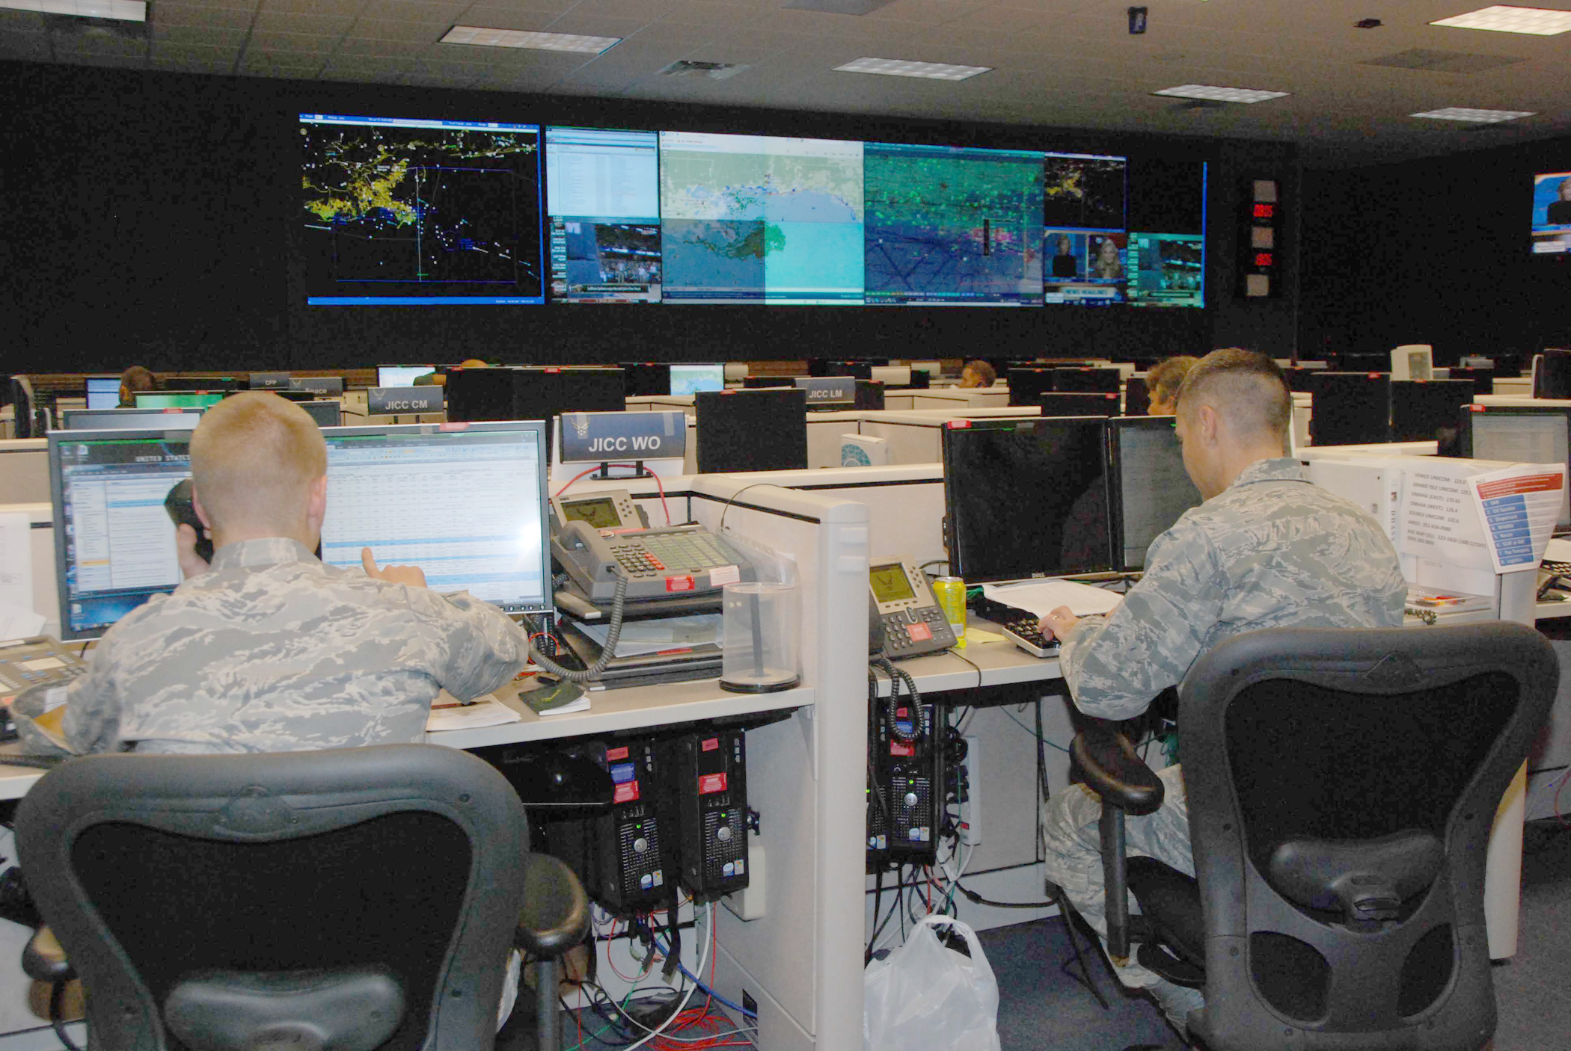
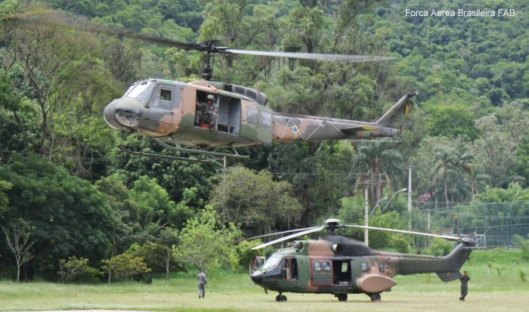
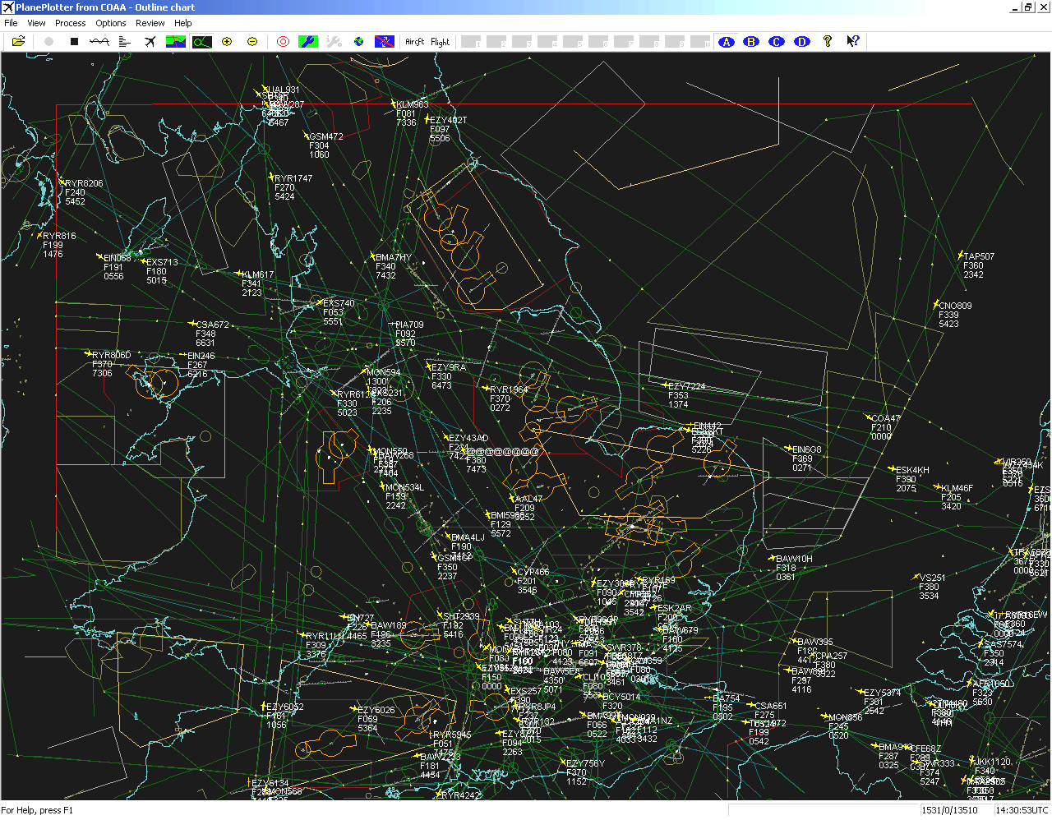
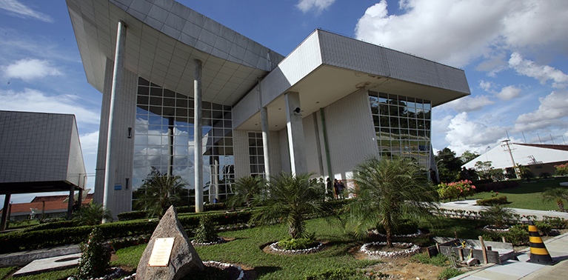
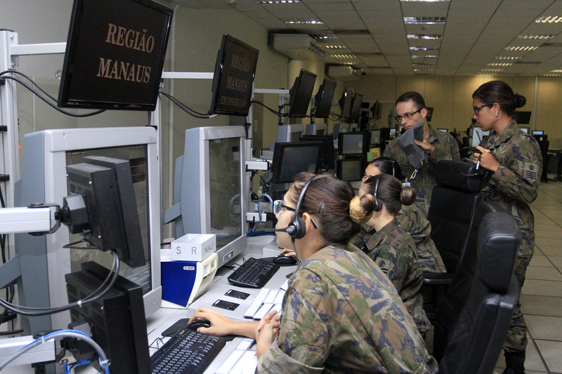
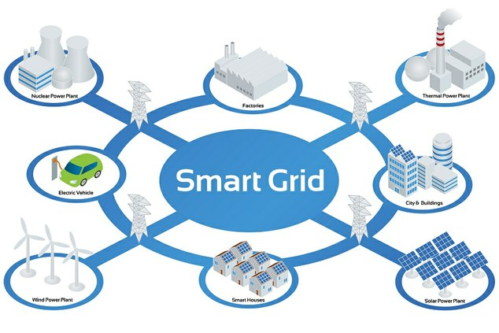
Who am I?
Brazilian Defense Cyber Ops
Brazilian Air Force Pilot
ATC & C2 Security Protocols Research
Utilities Security Architecture
ATC Services

Slide 6






Who am I?

Slide 7
Class Details
Sessions: Tuesday & Friday (12:00 - 14:00)
Office Hours (Mentoring): will be provided primarily via email, or if necessary, a time can be scheduled via zoom.
Email: barretoabb@tec.mx
Message (Remind): https://www.remind.com/join/tc2027c.

Slide 8
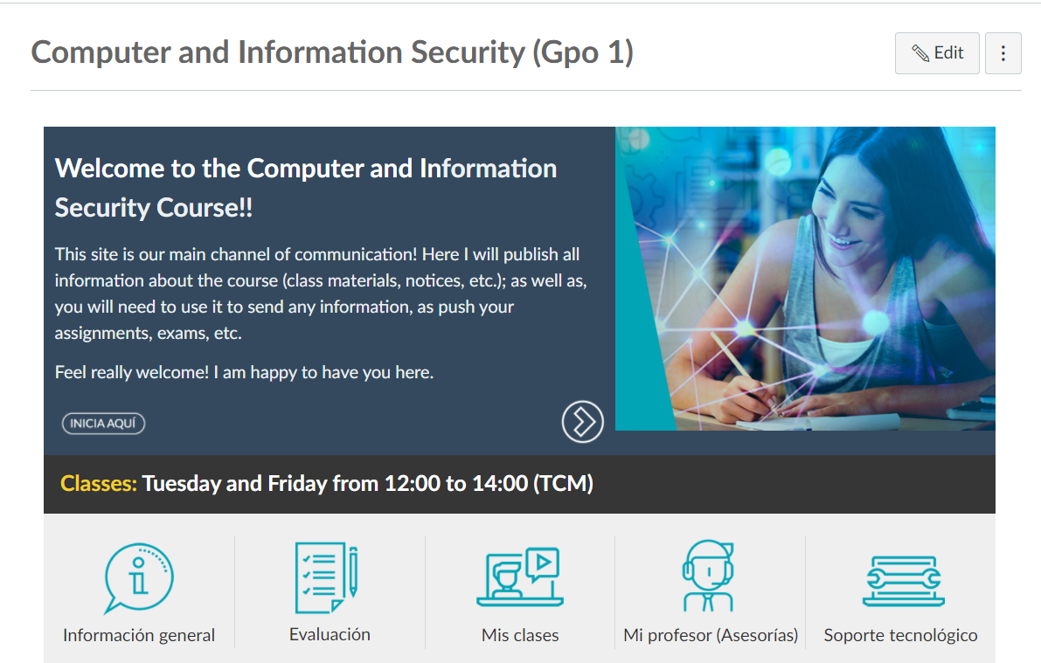
Syllabus and another course information:
https://experiencia21.tec.mx/courses/127251

Slide 9
Expected Behavior
Attendance is essential in all sessions.
Not all information is provided in the course text or notes
Good social practices to be observed
Enter or leave class at any time, but don’t disrupt the activity going on
Electronic devices in silent mode
Should you find yourself in extreme need to answer an incoming call, just leave the room to do so.
Assignments
Collaboration with peers is strongly encouraged, write-up must be your own
Students are responsible for keeping pace of the schedule changes
Academic and General policies are listed in the Syllabus

Slide 10
Academic Integrity
Honor code is your bible: https://mitec.itesm.mx/Paginas/mitec/index.aspx.
Three fundamental principles to follow at all times are:
All work submitted be your own;
When using the work or ideas of others, including fellow students, give full credit through accurate citations; and
If you are uncertain about the ground rules on a particular assignment, ask for clarification.
Avoid plagiarism
Provide an accurate and complete citation for any reference work used.
Paraphrased material must also be cited.
A simple listing of books or articles is not sufficient.
Plagiarism is the equivalent of intellectual robbery and cannot be tolerated in the academic setting.

Slide 11
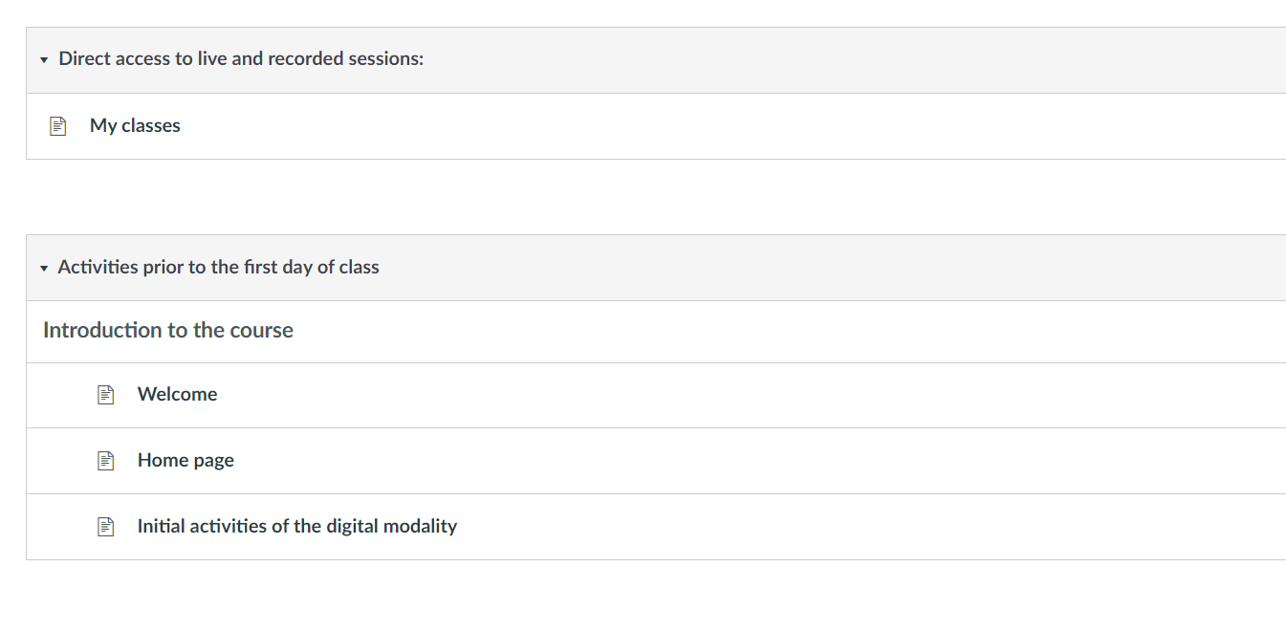
Course Outline
https://experiencia21.tec.mx/courses/127251/modules

Slide 12
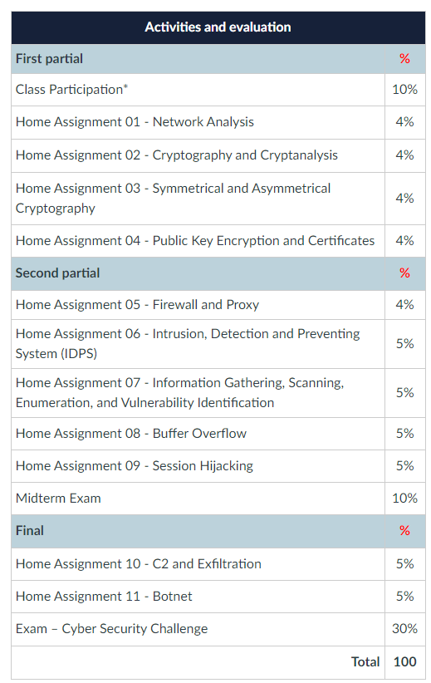
Evaluation
The required activities do not have a numerical value. However, they may be penalized if they are ignored.
To receive the activity's total points (10%), the student cannot miss any class and must perform all classroom activities, maintaining his own website on git. He will publish the codes developed in the classroom.

Slide 13
Exams and Assignments
There will be two major exams in the course
Midterm: take-home (individually)
Final exam: take-home (group)
Quizzes will be in-class, applied in an ad-hoc basis
Homework will be take-home (individually), usually on a bi-weekly basis

Slide 14
Exams and Assignments
General Directions:
Unless stated otherwise, I will present the solutions at the beginning of the next class after the assignment was handed
Handling your assignment after it is due but before I present the solutions you can earn a max of 70 points
An assignment handled after the solutions are posted will yield 0 points
Files should be named with the following convention:
TC2027_AssigmentTypeAndWeek_LastnameFirstname.pdf
TC2027_Hwk2_DoeJohn.pdf,
Not-so-good student (real) examples: hm.pdf, Joe.pdf, syst687.pdf, 1.pdf, etc.
If the activity is workgroup, it is required to have a main page with the name of team’s participants.

Slide 15
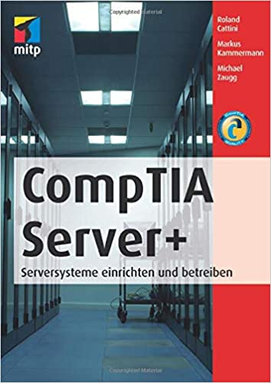

Course Reference
Ciampa, M. (2014). CompTIA security+ SYO-401 in depth. Nelson Education.
Other references distributed in class
Lecture notes
Pfleeger, C. P. (2002). Pfleeger, S L. Security in Computing.

Slide 16
Computer and Information Security (TC2027)

